Slide 1
Humanistic
Approach
Prof Omer Maaitah

Slide 2
INDEX
Introduction
Definition
Assumption
Critics
Principles and Qualities
Steps of implementation
Strength points
Limitations

Slide 3
INTRODUCTION
Humanistic, humanism and humanist are terms in psychology relating to an approach which studies the whole person, and the uniqueness of each the individual’s subjective experience, Also the humanistic approach is called Phenomenological.
Humanism approach has historically change in accordance with successive and diverse strands of intellectual thought. Humanism can be understood as a moral inspiration for critical reflection and positive action, aiming to establish a society based on peace, justice, democracy and human rights.

Slide 4
DEFINITION
A Humanist or phenomenological theory of planning stresses the unique ways that different groups come to possess knowledge, and the difficulty with which one group’s knowledge can be translated for others given the diversity of human daily experiences, perspectives and behavior.
clarification:
Phenomenological planning may involve seeing a house not as a “merely technological construction, but dwelling (house); not merely homogeneous and mathematized space, but place; not merely planetary raw material, but environment”
Place and space
Remote are is a Space
But it should be a place (belonging)

Slide 5
GENERAL ASSUMPTIONS
1. Humanistic is an approach based on the idea of human needs and human values.
2. Focusing on the subjective, practical and social conditions of all human experiences-from the epistemological experience to the ethical, political, religious, aesthetic and daily experience. 3. It depends more on subjective than objective research which aims to understanding human in his environment. 4. Humanistic studies human awareness, human consciousness, human creativity, human experience, a human expression, human thought and behaviour.
5. Planner as knower, to link knowledge with action in the process of planning. 6. The Humanist urban designer pays attention to small-scale elements and informal ordering systems. “Design in human scale achieves familiarity and the sense that things have been made by and for people.”

Slide 6
GENERAL ASSUMPTIONS
7. Humanist streets are domesticated and become livable places for people. "In the suburbs and slums the vital relationship between the house and the street survives, children run about, ...people stop and talk... dismantled vehicles are parked, . . . you know the milkman, you are outside your house in your street. . . . Streets should be places and not corridors or balconies." 8. Humanism rejects scientific methodology but focus collective experimentation as a method of planning and research, also typically uses qualitative research methods. For example, diary accounts, open-ended questionnaires, unstructured interviews and unstructured observations. Qualitative research is useful for studies at the individual level, and to find out, in depth, the ways in which people think or feel (e.g. case studies).The way to really understand other people is talk with them face to face, share their experiences and be open to their feelings.

Slide 7
Principles and Qualities
Phenomenology searches for the meaning or essence of an experience rather than measurements or explanations.
Researcher will describe their own experiences or ideas related to phenomenon to increase their own awareness of their underlying feelings.
This type of research focuses on the wholeness of the experience, rather than its individual parts.
Phenomenology differs from other research in that it does not test a hypothesis, nor is there an expectation that the results predictive or reproducible. Additional studies into the same phenomenon often reveal new and additional meanings.

Slide 8
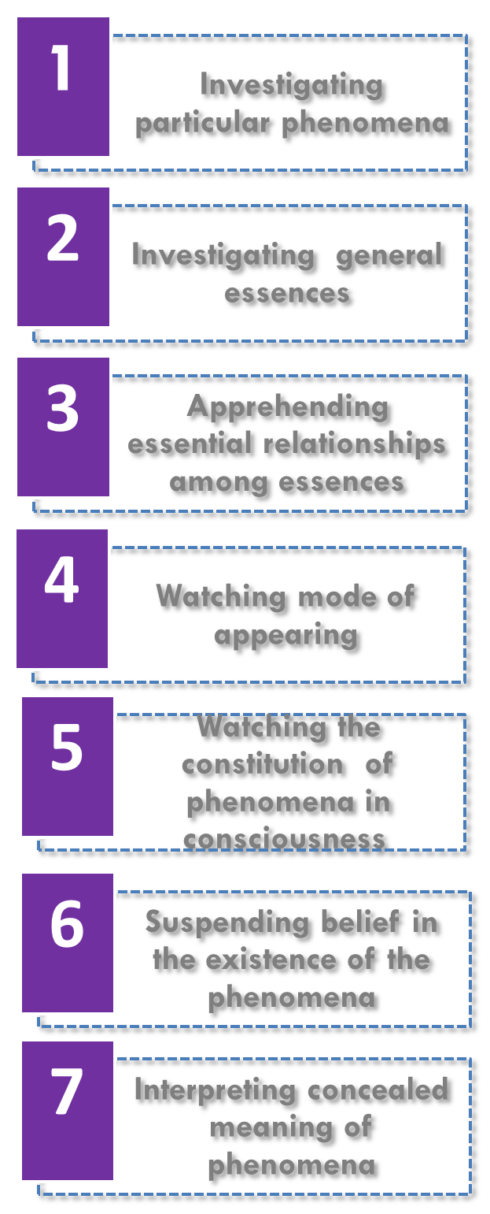
Strategy of implementation
“ aims at understanding the meaning of the phenomena of the lived-world of immediate experience, and then seeks to clarify these in a rigorous way by careful observation and description “

Slide 9
Steps of implementation
1) Investigating particular Phenomena
a.phenom. Intuiting . Without preconceptions
b. phenom. analyzing.
c. Phenom. describing :
i. metaphor and analogy.

Slide 10
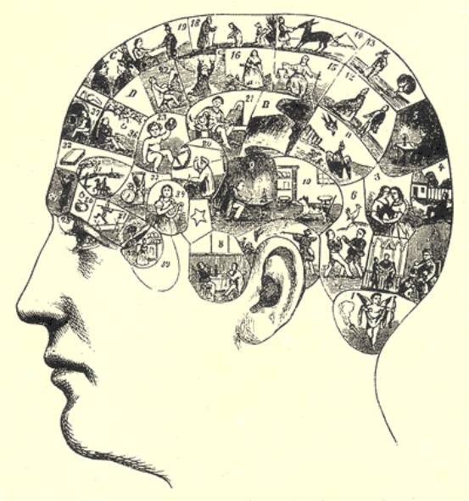
Steps of implementation
2) Investigating general essences (eidetic intuiting)
« Such particulars may be given either in perception or in imagination or in a combination of both.
• Another way to investigate essences is by lining up particular phenomena in a continuous series based on
the order of their similarities.

Slide 11
Steps of implementation
3) Apprehending essential relationships among essences
Phenomenology is not only concerned about components, but also with relationships or connections.
Two types of relationships:
a. Single (its) essence
b. Between several essences

Slide 12
Steps of implementation
4) Watching Modes of Appearing.
Phenomenology is the systematic exploration of the phenomena not only in the sense of what appears, whether particulars or general essences, but also of “the way in which things appear”.
5) Watching the Constitution of Phenomena in Consciousness.
It consists merely in determining the way in which a phenomenon establishes itself and takes shape in our consciousness. E.g. the way one creates a mental map of a city he is just visiting for the first time.

Slide 13
Steps of implementation
6) Suspending Belief in the Existence of the Phenomena.
The underlying idea is to detach the phenomena of our every day experience, while preserving their content as fully and as purely as possible. This might be useful in order to concentrate exclusively on the non- existential or essential content, the “what” of the phenomena.
7) Interpreting Concealed Meanings of Phenomena.
It is an attempt to interpret the “sense" of certain phenomena. It aims at discovering meanings which are not immediately manifest to our intuiting, analysing, and describing. Hence, the interpreter has to go beyond what is directly given.

Slide 14
Strength points
Seeks to find the universal nature of an experience and can provide a deeper understanding.
The qualitative nature of phenomenology allows the researcher to notice trends and look at the big picture. The data is not fit into a statistical test that confines or restricts the interpretation.
Helps to understand a lived experience and brings meaning to it.
Expand self-awareness
Mutual understanding exists between planner and client
Flexibility in interpersonal relationships

Slide 15
Limitations
The research participants must be able to articulate their thoughts and feelings about the experience being studied. It may be difficult for them to express themselves due to language barriers, age, cognition, embarrassment and other factors.
It may be difficult to gain access to participants.
Presentation of findings may be difficult. The subjectivity of the data may lead to difficulty in establishing reliability and validity.
Results may help expose misconceptions about an experience. It may be a means to have the voices of the participants heard which may prompt action or at least challenge pre-conceived notions and complacency.
Policy makers may give less credibility to phenomenological study.
Gathering data and data analysis may be time consuming and laborious (seek to elucidate – human subjectivity – does not make itself readily available for ease of investigation)

Slide 16
Critics
1-A phenomenological theory of planning procedure would encourage planners to note what objects in their communities have meaning, and how different frames of reference give different meanings to each object
2-Total immersion” with the local culture and becoming knowledgeable of local priorities, ethics, and lifestyles
3- Attention to perception, emotion, and feeling as legitimate sources of knowledge
& not consider the large-scale issues and overall needs of the city.
4-tendency to foreground human experience and to treat it as a source of knowledge and as a basis for action.
5-The planner as phenomenologist accepts the absence of absolute truths about the city or the world and instead seeks understanding in individual and group consciousness
6-a phenomenological mode of planning hopes to foster productive relationships between planners and the communities they serve by bracketing expertise and attending to emotion and feeling as legitimate sources of knowledge.

Slide 17
Critics
7-In this process, the planner’s role does not consist merely of shaping physical spaces but of shaping spaces of deliberation. (learn by facilitating equitable dialogic spaces.)
8-Implementing humanistic management concepts is difficult due to the complexity of human behaviour and of ethical questions in general, and it has many challenges.
9- The challenge for planning practice is to link knowledge to action within an inclusive and relational understanding of action
10-criticized the assumption that planners can use their knowledge, whether derived from education, data, or some other source remote from local knowledge, to formulate interventions that society will simply accept (no certain reference ).

